Slide 1


Introduction to Artificial Intelligence
Book: Artificial Intelligence, A Modern Approach (Russell & Norvig)
Ybralem B.

Slide 2

Chapter Six
Natural Language Processing(NLP)

Slide 3
Chapter Objective
Communicating, Perceiving, and Acting
Intelligent agents must interact with the world to achieve their goals. These interactions require communication, perception, and action.
This chapter explains how agents use these capabilities to understand and respond to their environments.

Slide 4
What is Natural language Processing
Natural language processing (NLP) is a subfield of artificial intelligence (AI) that focuses on enabling computers to understand and generate human language.
NLP plays a crucial role in facilitating communication between humans and intelligent agents.
It allows agents to interpret and respond to human instructions, extract information from text, translate languages, and engage in natural conversations.

Slide 5
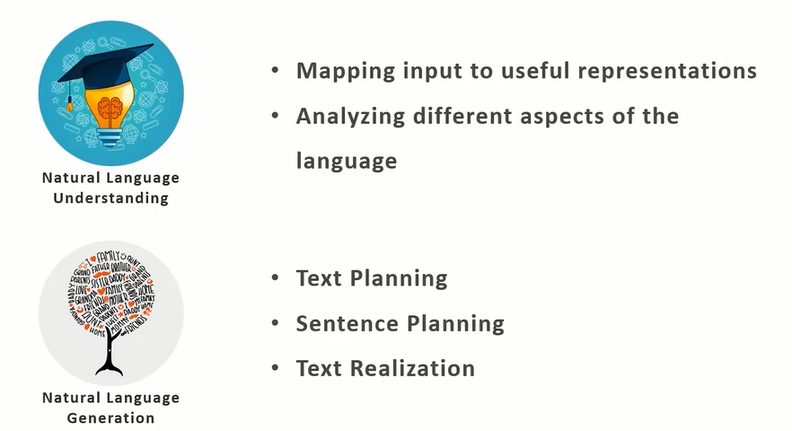
Key components of NLP
NLU is the process of reading and interpreting language.
NLG is the process of writing or generating language
  Example: A virtual assistant like Siri or Alexa:
  NLU: Understands the user query, "What’s the weather like tomorrow?"
  NLG: Generates a response, "Tomorrow’s forecast is sunny."

Slide 6
Techniques
NLP techniques process and analyze text using language models, statistical methods, and machine learning algorithms.
Language Models: Statistical models that predict the probability of a sequence of words.
  Examples : a bigram model that predicts the probability of a word given the previous word. "machine learning" would be scored based on how often "learning" follows "machine" in the training corpus. The more frequent the pair ML, the higher probability score
  Language models are statistical models that predict the likelihood of a sequence of words.
  They are used to understand and generate coherent text.
  Statistical Methods: Techniques like n-grams and TF-IDF for text analysis.
  N-grams: A sequence of "n" words used to represent text. For instance, a bigram consists of 2 consecutive words, while a trigram consists of 3 consecutive words. Breakdown texts in to smaller manageable units useful for analysis.
  TF-IDF (Term Frequency-Inverse Document Frequency): This method measures how important a word is within a document relative to the entire collection of documents.
    Term Frequency (TF): Measures how often a word appears in a document.
    Inverse Document Frequency (IDF): Measures how unique a word is across multiple documents.
    Result: Words that appear frequently in one document but rarely in others get higher importance scores.
  Machine Learning Algorithms: Supervised and unsupervised learning algorithms for tasks like text classification and language modeling.
  a Naive Bayes classifier can be trained on a labeled dataset of emails to distinguish spam from non-spam emails.

Slide 7
Applications
Text classification: categorizes documents based on their content.
  Examples: spam filtering and sentiment analysis.
  Spam filters analyze emails and classify them as spam or not spam based on the presence of specific words or phrases.
  Sentiment analysis determines the emotional tone of a text, such as positive, negative, or neutral, which can be valuable for understanding customer reviews or social media posts.
Information retrieval: involves searching and retrieving relevant information from large text databases, such as web search engines.
  For example, when a user enters a query in a search engine, the system retrieves relevant web pages based on keywords, links, and other factors.
Information extraction: extracts structured information from unstructured text, like named entities or relationships.
  For example, an information extraction system can process a news article and extract information about people, organizations, locations, and events.
Machine translation: automatically translates text or speech between languages. Online translation tools, such as Google Translate, rely on machine translation techniques to provide translations between various language pairs.
Dialogue systems: building conversational agents that interact with humans in natural language. Voice assistants, such as Siri, Alexa & Bixby, employ dialogue systems to understand and respond to user requests and questions.

Slide 8
Natural Language for Communication
This topic explains how agents use natural language for effective communication.
  Understanding the complexities of human language is essential for agents to engage in meaningful and productive interactions or communication
Key aspects of natural language communication for intelligent agents:
Syntax: The rules governing the structure of sentences. Agents need to parse and generate grammatically correct sentences.
  Example: a syntactic parser can analyze the sentence "The cat sat on the mat" and determine its grammatical structure, identifying the subject, verb, and object.
Semantics: The literal meaning of words and sentences regardless of the context. Understand and represent the direct meaning conveyed by the text.
  Example: a semantic analyzer can determine that the sentence "I am hungry" expresses a desire for food.

Slide 9
Natural Language for Communication
Pragmatics: The use of language in context. Agents need to consider the context of a conversation to interpret and generate appropriate responses.
  Example: if someone says "It's cold in here," the pragmatic interpretation could be a request to close a window or turn up the heat, depending on the situation.
Dialogue Management: Managing the flow of a conversation and ensuring coherence and relevance. Agents need to track the conversation history and generate responses that are consistent and contribute to the overall goal of the dialogue.
  Example: in a customer service chatbot, the dialogue management system keeps track of the user's previous questions and provides relevant information and assistance based on the context of the conversation.
Conversation Modeling: Building computational models that represent the dynamics of human conversations. These models help agents understand and generate human-like dialogue.

Slide 10
Challenges in Communication
Ambiguity:
  Natural language is inherently ambiguous, with words and phrases often having multiple possible meanings.
  Figurative language:
  Figures of speech like metonymy and metaphor pose challenges for AI systems trained on literal language. Metonymy uses one object to stand for another, while metaphor suggests a different meaning through analogy.
Context dependence:
  The meaning of text or sentence can depend heavily on the context in which it is spoken, requiring AI systems to have a sophisticated understanding of the situation and the speaker's intent.

Slide 11
Perception
Perception involves agents interpreting sensory input (like vision, hearing, or touch) from their environment to form a coherent understanding of the world.
Different sensory inputs:
a. Vision: Agents with visual perception can interpret images and videos to identify objects, recognize scenes, and understand their surroundings. This involves techniques from computer vision, such as:
  Image Processing: Enhancing and manipulating images to extract useful information. Examples include image filtering, edge detection, and color segmentation.
  Object Detection: Identifying and locating objects of interest in images or videos. This is used in applications like self-driving cars to detect pedestrians, vehicles, and traffic signs.
  Scene Understanding: Interpreting the overall context and meaning of a scene. This is crucial for tasks like robot navigation and image captioning.

Slide 12
Perception
b. Hearing: Agents with auditory perception can process sound signals to recognize speech, identify sounds, and localize sound sources. This involves techniques from:
  Speech Recognition: Converting spoken words into text. Speech recognition is used in virtual assistants, dictation software, and automated phone systems.
  Auditory Scene Analysis: Separating and identifying different sound sources (distance and direction) in a complex auditory environment. This is important for robots operating in noisy environments or agents that need to understand the soundscape around them.
  c. Touch: Agents with physical perception can gather information about objects through physical contact, like texture, shape, and temperature. This is important for:
  Robots that need to manipulate objects or navigate in cluttered environments.
  Agents that interact physically with their surroundings.
Sensor Fusion: Integrating information from multiple sensors enhances perception and creates a more robust understanding of the environment. Combining visual and auditory information,
  Example: can improve speech recognition in noisy environments or enhance object recognition by considering both appearance and sound.

Slide 13
Challenges in Perception
Sensor noise:
  Sensors provide noisy and incomplete information about the environment, making it difficult to construct an accurate representation of the world.
Partial observability:
  Agents often have limited access to the environment, meaning they must reason about the state of the world based on incomplete sensory data.
Ambiguity:
  Sensory inputs may have multiple interpretations, requiring prior knowledge or strategies to resolve.
  Dynamic environments:
  The world is constantly changing, requiring agents to adapt their perceptions and actions in real-time. This requires efficient mechanisms for updating internal representations and making decisions in dynamic settings

Slide 14
Robotics
Robotics is a field that deals with the design, construction, operation, and application of robots.
Robots are physical agents that can perceive their environment, make decisions, and take actions to achieve specific tasks.
Key areas within robotics:
Robot Hardware and Sensors: The physical components of robots, including their mechanical structure, actuators, sensors, and power systems. Choosing appropriate sensors for perception is crucial for robots to interact effectively with their environment.
  Example: a self-driving car needs a variety of sensors, including cameras, lidar, and radar, to perceive its surroundings.
Robot Control and Navigation: Developing algorithms and techniques for controlling robot movements and enabling them to navigate in various environments. This includes:
  Path Planning: Finding a sequence of movements to reach a destination while avoiding obstacles.
  Obstacle Avoidance: Detecting and avoiding obstacles in the robot's path.
  Motion Control: Controlling the robot's actuators to achieve smooth and precise movements.

Slide 15
Robotics
Robot Learning and Adaptation: Enabling robots to learn from their experiences and adapt to changing environments. This includes techniques from:
  Machine Learning: Training robots on datasets to perform tasks like object recognition or grasping.
  Reinforcement Learning: Allowing robots to learn through trial and error by receiving rewards for desired behavior.
Human-Robot Interaction and Collaboration: Designing robots that can interact safely and effectively with humans in various settings. This involves:
  Understanding human behavior: Robots need to be able to interpret human actions and intentions to collaborate effectively.
  Designing intuitive interfaces: Robots should be easy for humans to control and interact with.
  Ensuring smooth collaboration: Robots and humans should be able to work together seamlessly to achieve common goals.

Slide 16
Challenges in Acting
Uncertainty:
  Agents often need to act in uncertain environments, where the outcomes of actions are not fully predictable. This requires decision-making mechanisms that can handle nondeterminism and partial observability.
Planning complexity:
  Finding optimal plans in complex environments can be computationally challenging. Techniques like hierarchical planning and multiagent planning can help manage this complexity by decomposing problems into smaller subproblems and coordinating actions among multiple agents.
Real-time constraints:
  Agents often need to make decisions and take actions in real-time, with limited computational resources. This requires efficient algorithms and representations that allow for timely responses to changing situations.
Overall, building AI agents capable of effective communication, perception, and acting in complex real-world environments remains a significant challenge. Overcoming these challenges requires ongoing research in areas such as natural language processing, computer vision, robotics, and machine learning.

Slide 17
Conclusion
Intelligent Agent:
An intelligent agent receives percepts from the environment and performs actions. Its behavior is determined by an agent function that maps percept sequences to actions.
Example, a simple thermostat can be considered an intelligent agent. It receives percepts about the current temperature and takes actions (turning the heating or cooling system on or off) to maintain the desired temperature.
Types of Agent Representations: Agents can use atomic, factored, or structured representations to model their environment and make decisions.
  Atomic representations treat states of the world as indivisible units without internal structure. For instance, in a simple grid world, an atomic representation might represent the agent's location as a single cell without considering the specific details of the cell.
  Factored representations depict states using sets of attribute-value pairs. In the grid world example, a factored representation could represent the agent's location using attributes like 'x-coordinate' and 'y-coordinate'.
  Structured representations model the world as composed of objects and relationships between them. A structured representation could describe the grid world with objects like 'agent', 'walls', and 'goals', along with relationships like 'adjacent to' or 'at location'.
Rationality:
A rational agent acts to maximize the expected value of its performance measure given the percept sequence it has observed.
  For instance, a chess-playing AI is rational if it chooses moves that maximize its chances of winning the game.
The concept of an intelligent agent, its representations, and its rationality are fundamental to understanding AI's core principles. These concepts form the basis for designing agents that can effectively communicate, perceive, act, and solve problems in various domains.

Slide 18
Issues Associated With Social Technical And Ethical Uses Of AI
Amazon’s AI recruiting tool displays bias towards women
The eCommerce giant deployed the experimental AI recruiting tool using a five-star rating system that scored their likelihood of getting software and technical job roles at the company.
The pattern detection capabilities of Amazon’s recruitment tool AI were trained to spot similarities across applicant resumes. To achieve this, they had been analyzing countless applications for up to a decade.
With those typically assuming technical and software positions in the past being disproportionately men, Amazon’s AI algorithm began to skew reasoning toward these preferences.
The AI began showing signs of sexism, lowering scores for resumes from women and steering its preferences toward male candidates. Applicants who had attended one or more all-female universities were also ranked lower.

Slide 19
….
United Nations Development Program finds AI image generators misrepresent STEM professions
Generative AI (GenAI) applications have given rise to diverse forms of AI. Underpinning GenAI are large language models (LLMs) that communicate and understand users through natural language capabilities.
LLMs have helped fuel the popularity of image generators like Midjourney and DALL-E, which artificially create detailed and stylized images in minutes.
While exploring gender gaps in STEM professions, researchers at the United Nations Development Program’s (UNDP) Accelerator Lab assessed how two popular AI image generators, DALL-E 2 and Stable Diffusion, perceived women in STEM professions.
When prompted to generate visual images of the words “IT expert,” “mathematician,” “scientist,” or “engineer,” both DALL-E 2 and Stable Diffusion reflected societal stereotypes, illustrating that men naturally fit STEM positions over others.

Slide 20
….
Google’s online advertising system favored showing high-paying jobs to men over women
Researchers at Carnegie Mellon University launched an auto-testing tool that showed how online recommendation engines such as Google Ads display gender bias. Dubbed AdFisher, the tool deployed over 17 thousand fake profiles simulating male and female jobseekers.
The profiles were exposed to over half a million job adverts, and researchers were able to run rigorous browser-based experiments that assessed for bias.
Findings show that high-paying coaching jobs offering over $200k annual salary were advertised 1,852 times to men and only 318 times to women. Generic ads, such as an auto-dealer position, were recommended to the female profiles.
Looking closely at Google’s ad settings matters, especially because of its size and global influence. Google uses browsing history, online activity, cookies, and personal info to decide who sees which ads—while giving users some control. But the way AI uses this data can affect which groups are targeted, and differences in targeting don’t always mean bias. https://www.digital-adoption.com/ai-bias-examples/

Slide 21
…..
Fairness/AI bias
AI’s impact on jobs
AI and privacy
Transparency (human-in-the-loop mechanisms)
Accountability
Reliability and safety
Privacy and security
Inclusiveness
Who owns the right to AI generated content or innovations? As AI systems become more creative, this question will become increasingly pertinent.
Deepfakes can be used to create forged identity documents or photos for fraudulent purposes, such as opening bank accounts, obtaining loans, or gaining access to secure locations. This can lead to financial fraud and other security breaches.
There are a number of ethical considerations to be aware of when using Generative AI. These include, but are not limited to, the following:
Bias, misrepresentation, and marginalization
Hallucinations, misinformation and disinformation
Privacy and data protection
Copyright and authorship
Labor exploitation
Environmental impact (Training and running large AI models consumes substantial energy, contributing to carbon emissions)
https://butlercc.libguides.com/facultyai/ethics

Slide 22
Some of the solutions:
Diverse datasets, implement fairness-aware algorithms, and continuously audit AI systems for biased outcomes.
Fully autonomous systems, especially in critical areas like healthcare, transportation, and the military, should be designed to include human-in-the-loop mechanisms.
If access is limited to only a privileged few, AI could exacerbate existing inequalities. Efforts are required to democratize AI, ensuring that it is accessible and beneficial to all segments of society, including underserved and marginalized communities. This includes investing in education and infrastructure to bridge the digital divide.

Slide 23
…
For Training and running large AI models consumes substantial energy, contributing to carbon emissions. Encourage academia and industry to develop low-carbon AI techniques and use renewable energy.
Continuous improvement practices should be in place to update AI systems based on new ethical insights, technological advancements, and societal needs.
For ownership it will be good to establish clear guidelines and policies to address these issues, balancing the interests of AI developers, users, and the broader society.
AI governance refers to a set of rules, standards, and processes that have been set in place in order to ensure the responsible and ethical development and deployment of artificial intelligence systems. Like it is a set of guard rails to ensure the ethical use of these artificial intelligence systems so that we minimize the risk

Slide 24
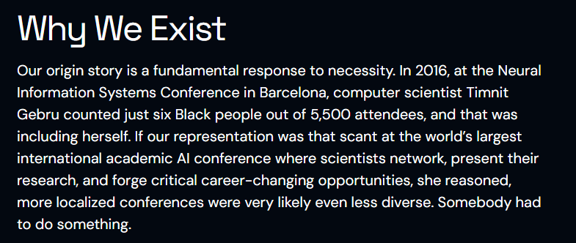
For your Knowledge: Black in AI

Slide 25
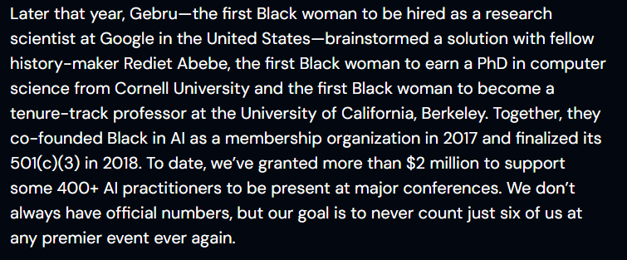
Black in AI

Slide 26
Questions ?

